Slide 1





PRESENTATION 2026
Student Name
Student Email
KRUPA SOLANKI
krupa111666@gmail.com
Mentor Name
UMA MAHESWARI

Slide 2

Outline
Abstract of the Project
Problem Statement
Proposed Solution
System Architecture
Live Demo of the Project
Embedded Video of Project
Conclusion
Future Scope

Slide 3
Abstract
This project focuses on inventory analysis using data analytics techniques to improve stock management. The objective is to identify high-risk and slow-moving products using turnover ratio and sales data. Tools like Excel and Microsoft Power BI were used for data cleaning, analysis, and visualization. The project provides interactive dashboards that help businesses make better inventory decisions. The expected outcome is improved stock optimization and reduced losses due to unsold products.

Slide 4

Problem Statement
Retail businesses face challenges in managing inventory efficiently, leading to overstocking, understocking, and dead stock. This problem affects profitability and operational efficiency. Existing methods lack proper data analysis and visualization. This project focuses on identifying product performance and risk levels using data-driven techniques to improve decision-making.

Slide 5

Proposed Solution
The proposed solution uses data analytics to evaluate product performance based on turnover ratio and sales trends. The dataset is cleaned and processed in Excel, and risk levels are assigned to products. Interactive dashboards are created in Microsoft Power BI to visualize insights. This solution helps identify slow-moving and high-risk products, enabling better inventory management.

Slide 6
System Architecture
Data Input / Source
Processing / Analysis
The dataset includes product details such as stock quantity, sales, price, supplier, and customer ratings. The data is created and managed in Excel.
Data cleaning, transformation, and calculation of turnover ratio are performed in Excel. Risk levels are categorized into high, medium, and low based on performance.
AI / Tool Integration
Output / Dashboard
Tools like Excel and Microsoft Power BI are used for analysis and visualization. Power BI provides interactive dashboards with charts, KPIs, and slicers.
The final output is a dashboard that includes KPIs, charts, and filters to analyze inventory performance and risk levels.

Slide 7
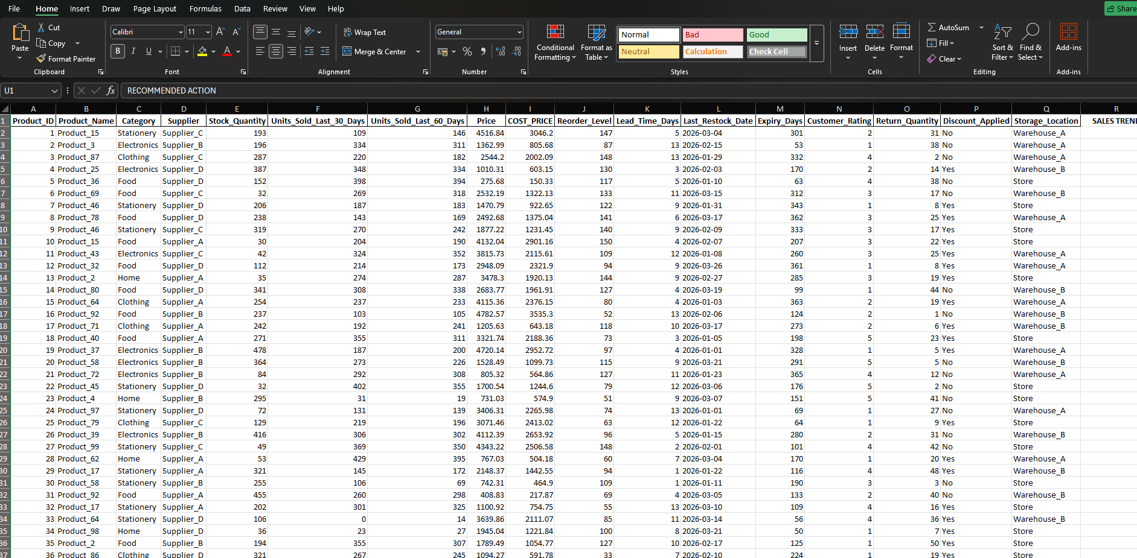
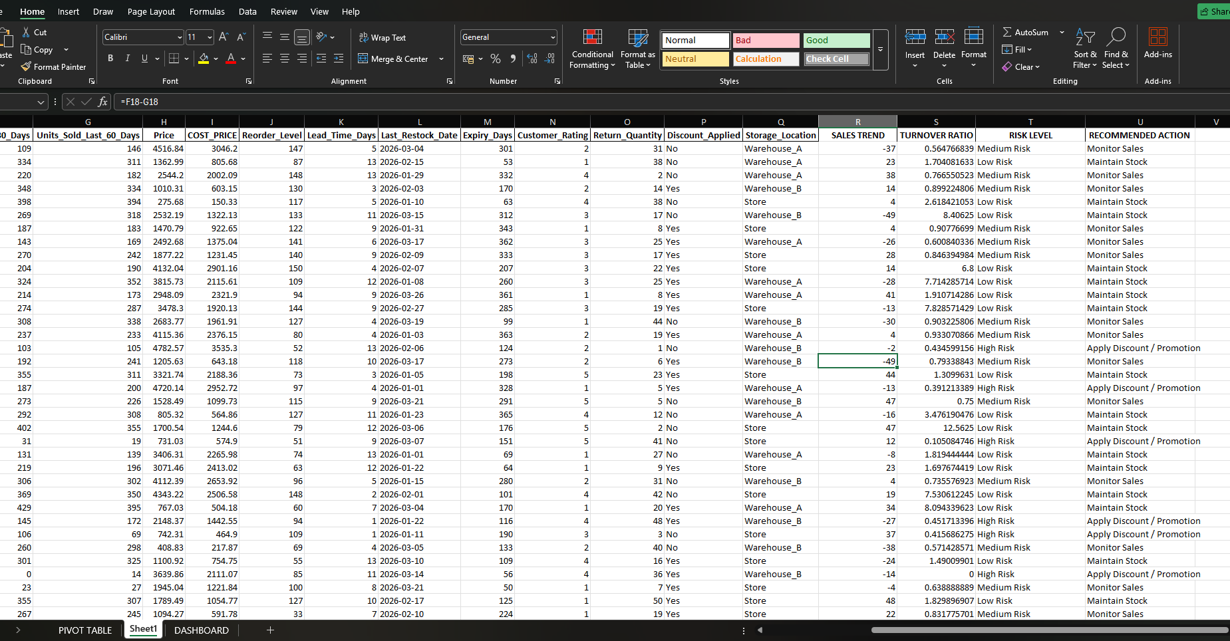
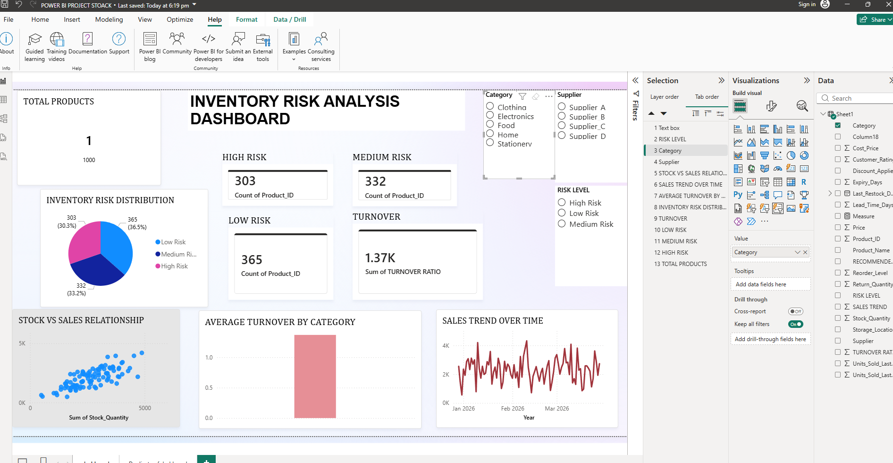
Live Demo of Project
Here's the list of some demo screenshots of the project:
CLEAN DATA
DASHBOARD
DATASET
Demo 1
Demo 2
Demo 3
[Add description of Demo 1 here — what this demo shows, key features, and results achieved.]
[Add description of Demo 2 here — what this demo shows, key features, and results achieved.]
[Add description of Demo 3 here — what this demo shows, key features, and results achieved.]

Slide 8
Video of Project Demo
[https://your-project-demo-link.com]
▶
[Insert your project demo video.
You can embed a video your live project.]

Slide 9

Conclusion
This project successfully analyzes inventory data to identify high-risk and slow-moving products. The dashboards provide valuable insights for improving inventory management. The objectives of the project were achieved, and it demonstrates the importance of data analytics in business decision-making.
CONCLUSION

Slide 10

Future Scope
Future improvements include real-time data integration, AI-based demand prediction, and automated inventory recommendations. The system can be expanded to include more advanced analytics and integration with business systems.

Slide 11
Thank You
AICW Fellowship | Student Project Presentation 2026
LinkedIn | Edunet Foundation

